Slide 1
SenNet + HOA Hacking the Human Vasculature in 3D
OJIMA Ryoji

Slide 2
Agenda
Background
Overview
Neural Network
Data
Post Processing

Slide 3
Background

Slide 4
My background
Education
Bachelor of Arts (Japanese Language and Literature)
Experience
Developer at BIPROGY Inc. over 30 years
Developing business applications
Applying various methodologies and frameworks
Technical lead at my company’s subsidiary in Viet Nam
Recent 10 years, I joined to research development of my company
Writing programs for Combinatorial Optimization Problems, Deep Learning, and Parallel Computing

Slide 5
What I do in my company last year
DIVP（Driving Intelligence Validation Platform）
A Simulator for autonomous driving
I wrote the millimeter wave radar module
TFDA（Topological Flow Data Analysis）
A library which converts flow data to text expression
I re-wrote python programs in C++ to make them faster
Programming Concours of my company
My company holds a programming competition every year
I created questions and ran the competition

Slide 6
What I do in my company last year
DIVP（Driving Intelligence Validation Platform）
A Simulator for autonomous driving
I wrote the millimeter wave radar module
TFDA（Topological Flow Data Analysis）
A library which converts flow data to text expression
I re-wrote python libraries in C++ to make them faster
Programming Concours
My company holds a programming competition every year
I created questions and run the competition
Experiences of 3D graphics!
Experiences of algorithms!

Slide 7
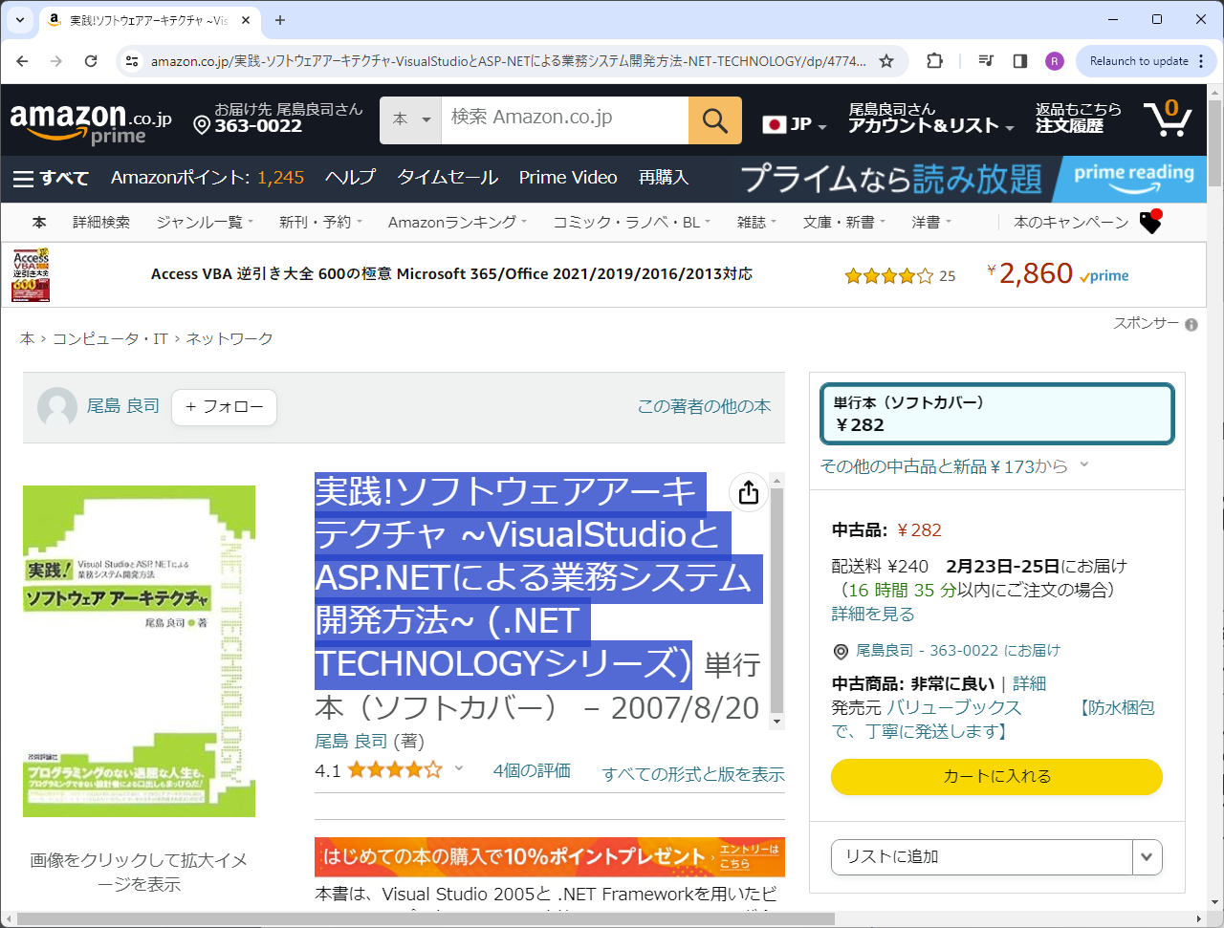
What I did outside of my company
PyQUBO（https://github.com/recruit-communications/pyqubo）
A library creating QUBOs or ising models from mathematical expression
https://github.com/recruit-communications/pyqubo/pull/98
Re-writing all C++ related code. 1.3x faster, less than ½ memory
実践!ソフトウェアアーキテクチャ
https://www.amazon.co.jp/%E5%AE%9F%E8%B7%B5-%E3%82%BD%E3%83%95%E3%83%88%E3%82%A6%E3%82%A7%E3%82%A2%E3%82%A2%E3%83%BC%E3%82%AD%E3%83%86%E3%82%AF%E3%83%81%E3%83%A3-VisualStudio%E3%81%A8ASP-NET%E3%81%AB%E3%82%88%E3%82%8B%E6%A5%AD%E5%8B%99%E3%82%B7%E3%82%B9%E3%83%86%E3%83%A0%E9%96%8B%E7%99%BA%E6%96%B9%E6%B3%95-NET-TECHNOLOGY/dp/4774131784

Slide 8
Overview

Slide 9
Overview
3D U-Net
Data augmentation using random positions and rotations
Post-processing which removes small positive chunks
……and I gave up early

Slide 10
Neural Network

Slide 11
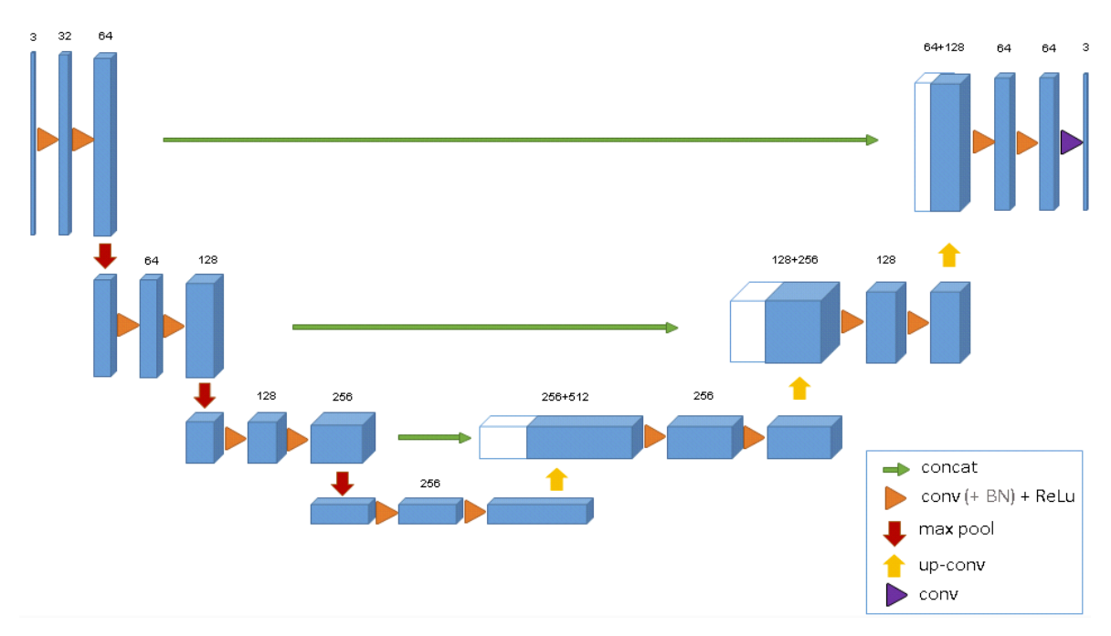
I choosed 3D U-Net
https://arxiv.org/abs/1606.06650

Slide 12
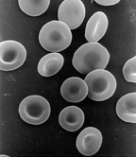
Is 3D U-Net effective?
Maybe not…
The geometry of blood vessels is simple: in 2D images, the outer wall of a vessel may be a ring, two parallel lines, or in very unfortunate cases, a single line. Except in the case of a single line, the 2D U-Net will be able to identify it.
https://en.wikipedia.org/wiki/Red_blood_cell
Ex. red blood cells. We need to check its shape is biconcave disk, disk, or ring. I think 3D U-Net is effective.

Slide 13
Why did I choose 3D U-Net
A colleague is writing a rheumatology diagnosis program that uses x-ray images as input.
He says that statistical processing, not machine learning, is sufficiently accurate when x-ray images are used as input.
In the future, we will use CT and MRI images as input.
In order to prepare for such a case, I wanted to learn about 3D U-Net.
The geometry of the bone joints is complex, I think.
I never thought I could be a Kaggle winner… I’m using Kaggle as a place to study…

Slide 14
Neural Network
3D U-Net
Input shape is 128 x 128 x 32; It's the limit of my computer
Using ResNet instead of simple convolution
Using UpSampling instead of UpConvolution
Training
Using focal loss and cosine decay scheduling
Epoch size is 700, batch size is 4
The training period is over 2 weeks on my computer

Slide 15
Data

Slide 16
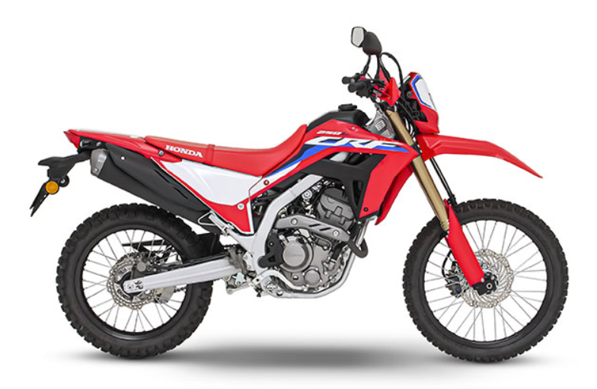
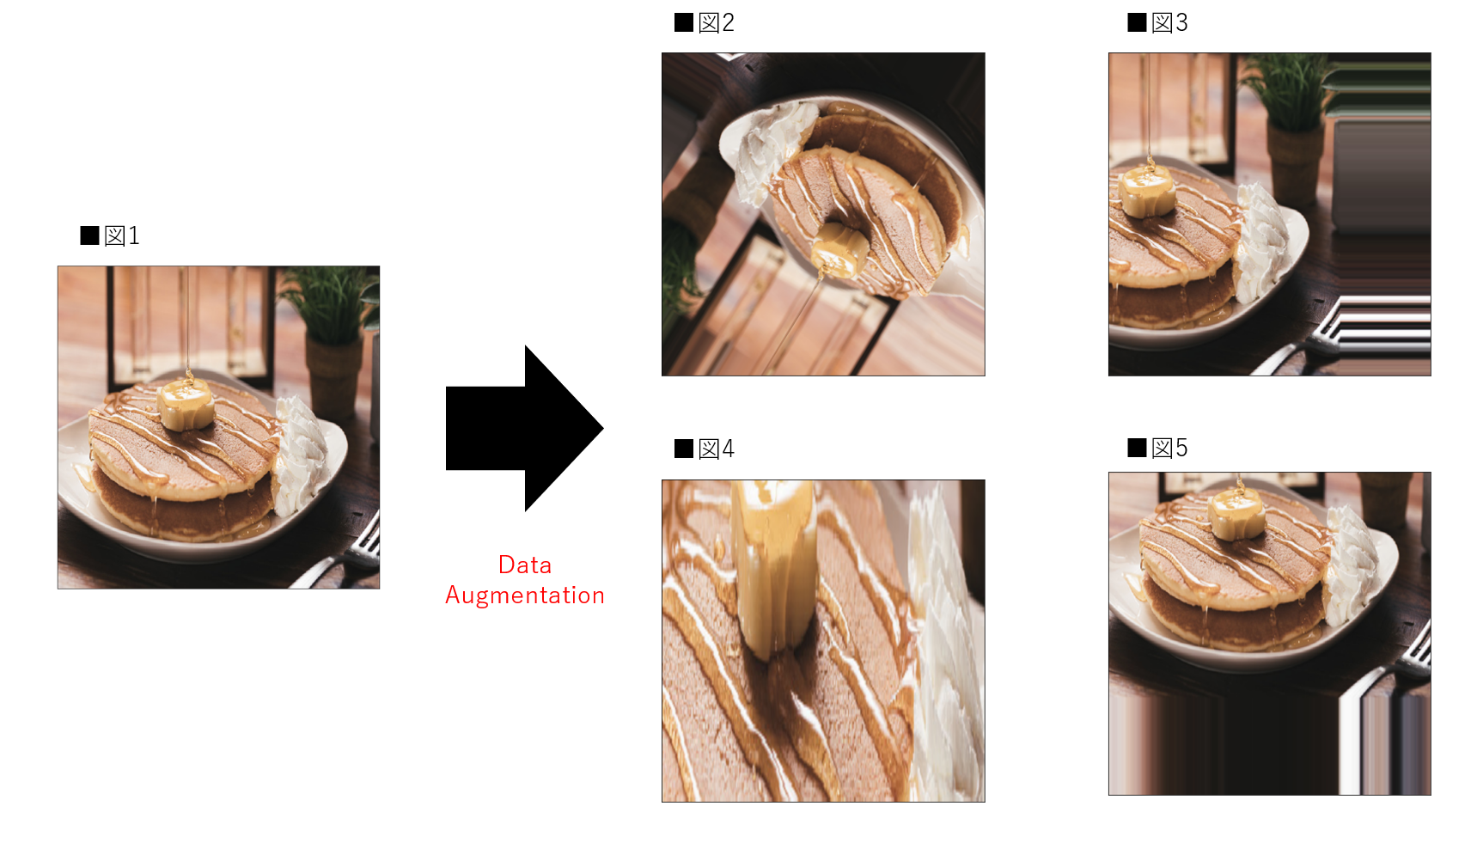
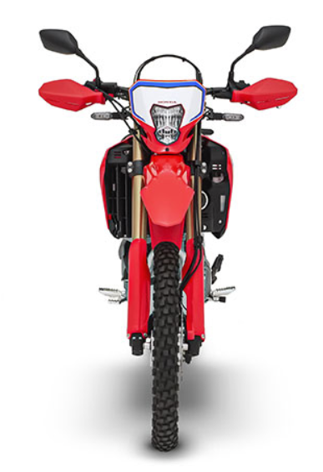
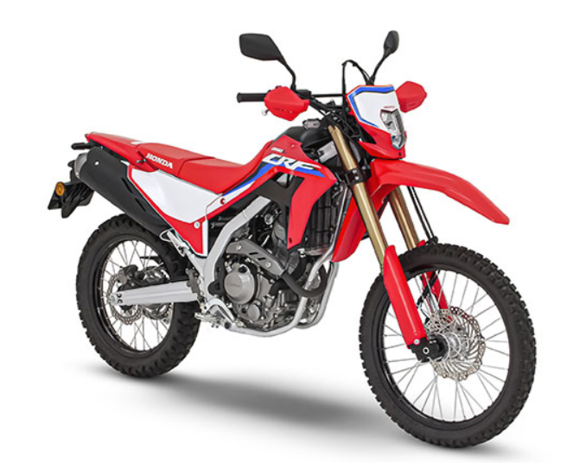
2D or 3D?
Data augmentation with 2D data
Incorrect data…
If 3D
All data are correct!
https://www.codexa.net/data_augmentation_python_keras/
https://www.honda.co.jp/CRF250L/type/

Slide 17
3D is good for data augmentation
If data is 3D…
Different and correct data can be produced by just changing the position of the camera
What matters in deep learning data is quantity…
But if the quantity is the same, the better quality is good.

Slide 18
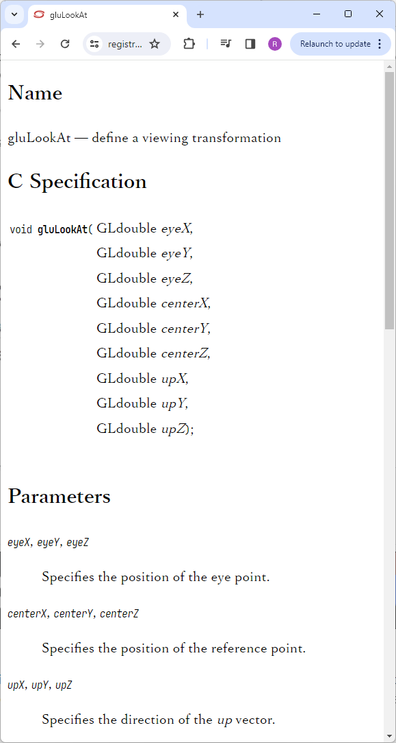
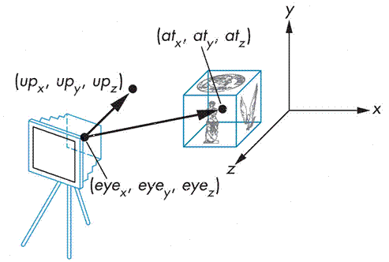
How to represent camera
In 3D graphics programming…
eye, center (at), and up are used for the camera.
https://slideplayer.com/slide/13057047/

Slide 19
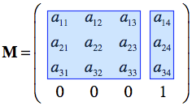
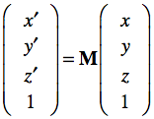
How to convert data
In graphics programming…
Affine transformation is used for view transformations
But I need to get (x, y, z) from (x’, y’, z’)…
I use np.linalg.inv()
https://www.brainvoyager.com/bv/doc/UsersGuide/CoordsAndTransforms/SpatialTransformationMatrices.html

Slide 20
Data
My program will made 30,000 data every 4 epochs by changing the position of camera
And epoch size is 700… Over 5M data!
I used multiprocessing and NumPy functions for performance
Using kidney_1_dense, kidney_2, and kidney_3_sparse
To avoid overfit, data from multiple patients and multiple manufacturers were needed, I thought

Slide 21
Post Processing

Slide 22
I thought…
Using sparse data -> maybe false negatives
My program adjusts the threshold to obtain 0.2% positives
At first and highest private LB score version, my program just uses 0.25 for threshold
The lower threshold -> maybe false positives
My program finds positive chunks and removes small positive chunks
At first and highest private LB score version, my program only search the biggest chunk
How to find positive chunks?
Depth-first search, I used

Slide 23
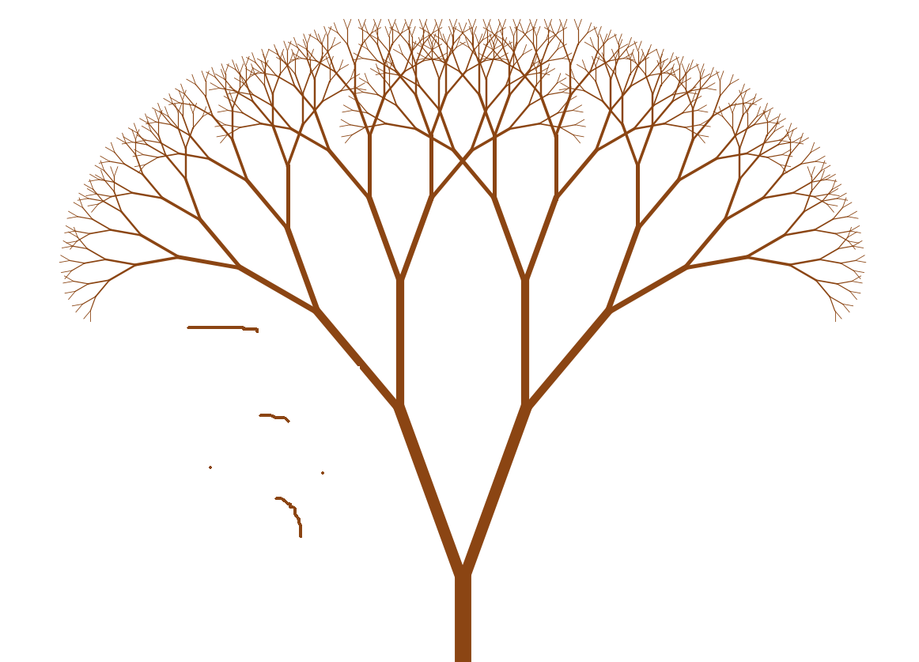
Blood vessels should be connected
No connection -> No blood flow -> Not blood vessels
Removing these chunks

Slide 24
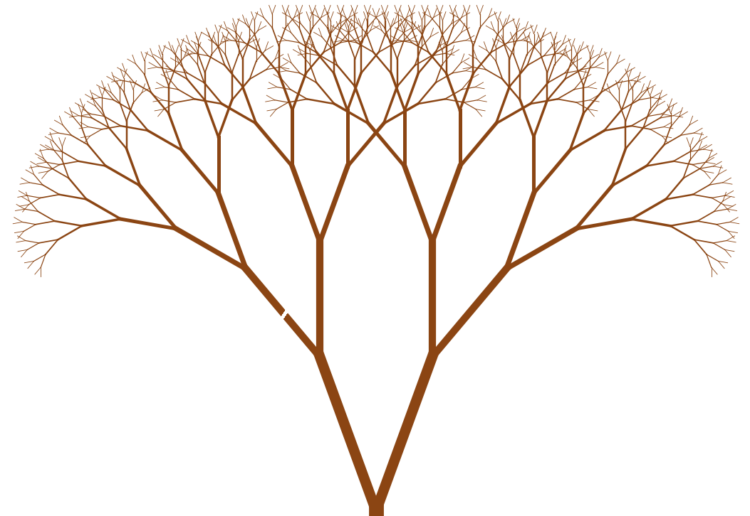
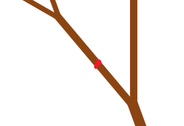
I planned, but I couldn’t…
Sometimes there will be small gaps…
Repairing!

Slide 25
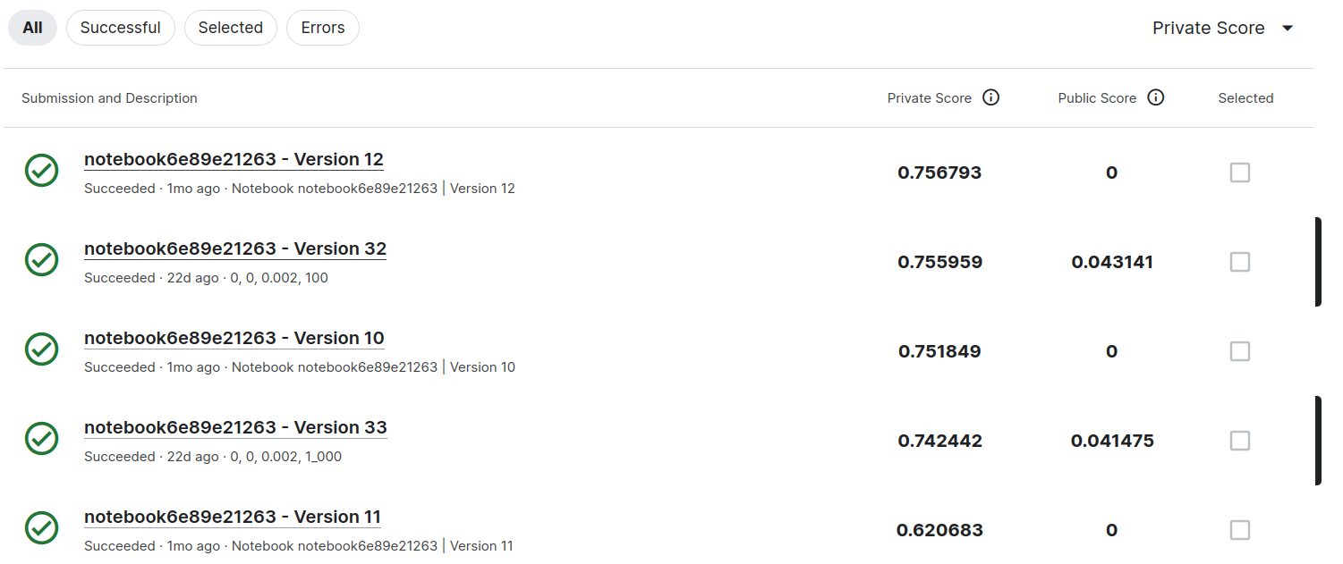
Although my plan is meaningless…
Big gap here
The generalization performance of my predictor is poor…
Since my predictor is poor…
I should re-create a better predictor before update my post-processing code…

Slide 26
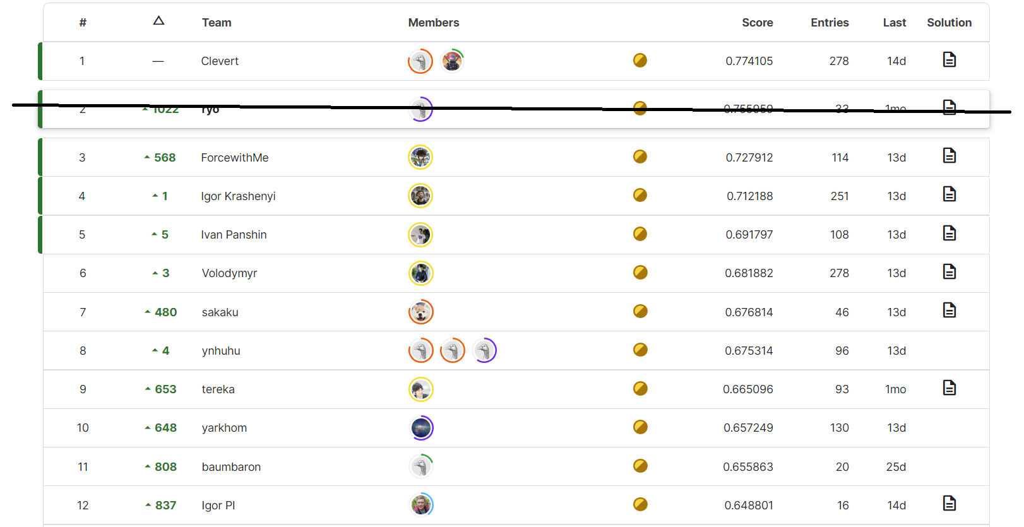
But…
SenNET and HOA got great predictors from this competition!

Slide 27
If we use these great predictors…
We can make an effective blood vessels annotation support app
Predict blood vessels with predictors not mine
Find chunks like my program
Remove unconnected, distantly placed chunks
Repair gaps automatically and professionals judge they are correct or not
Some chunks are maybe fat when low thresholds are used. Professionals tune the threshold for each chunks

Slide 28
Any questions?
My English is poor, so please think of me as a kindergartener and ask questions slowly, using simple words.

